Slide 1
Working with Plug-ins
Lesson 07

Slide 2

Lesson Objectives
Introduction
jQuery UI
jQuery Plug-in Repository
Closures
Plug-in Types
Function Plug-in
Method Plug-in
Working with Plug-in Options
Creating Private functions
Notes:
Explain the lesson coverage

Slide 3
Introduction
Plug-in is a piece of software which enhances another software application and usually cannot be run independently.
jQuery offers a mechanism for adding methods and extra functionalities to the core module by creating plug-ins. Additional methods and functions created using this structure are then bundled as plug-ins.
jQuery plug-ins are coded by making use of the jQuery API functions and methods.
jQuery Plug-in results in creating a reusable resource that we don't need to rewrite in our project.
Notes:
Additional notes for instructor

Slide 4
jQuery UI
jQuery offers a plug-in architecture that allows web developers to extend the core jQuery library (jqueryui.com).
It has following plug-ins
Effects plug-ins
  It make elements bounce, explode, pulsate, or shake.
Interaction plug-ins
  It enable users to interact with elements by making those elements draggable, droppable, or sortable etc.
Widget plug-ins
  Widgets saves tons of coding time and complexity while creating usable and responsive user interface elements.
Notes:
Additional notes for instructor

Slide 5
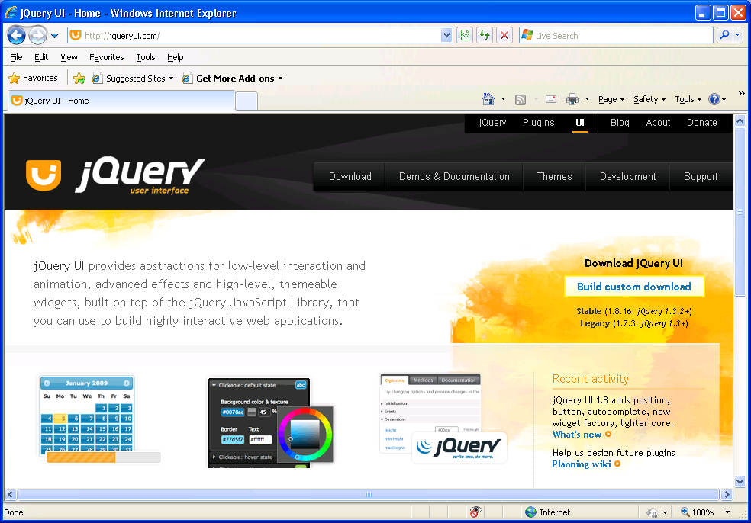
jqueryui.com

Slide 6
Demo
jQueryUI.html
Notes:
Add the notes here.
Additional notes for instructor

Slide 7
jQuery Plug-in Repository
http://plugins.jquery.com is official jQuery plug-in repository, where jQuery plug-in developers submit their plug-ins.
We can look for the best plug-ins from this repository.
We can browse plug-ins by category, by name, date or by search for a string.
We can get a valuable and versatile final product very easily and eventually we can tweak it to fit our needs from this repository.
Notes:
Additional notes for instructor

Slide 8
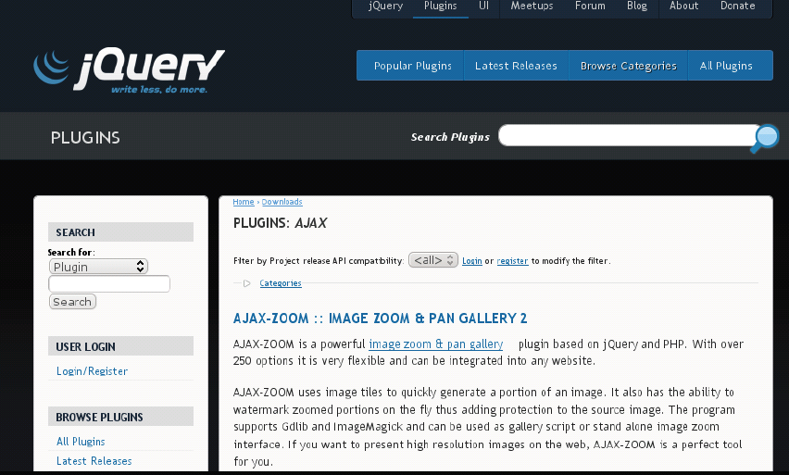
plugins.jquery.com
Notes:
Additional notes for instructor

Slide 9
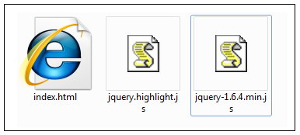
jQuery Plug-in naming convention
jquery.PLUGINNAME.js is the recommended file name convention for jQuery plug-ins.
For instance, if we create a plug-in to highlight elements, we need to name it as jquery.highlight.js
Place the index.html in the same location, which shows the demo for using the plug-in.
Notes:
Additional notes for instructor

Slide 10
Closures
A closure is used when a function is declared inside another function.
A closure is the local variables for a function - kept alive after the function has returned.
A closure is a stack-frame which is not de-allocated when the function returns.
A closure in JavaScript is like keeping a copy of the all the local variables, just as they were when a function exited.
Notes:
Additional notes for instructor

Slide 11
Demo
closure.html
Notes:
Add the notes here.
Additional notes for instructor

Slide 12
jQuery Plug-in Types
jQuery plug-ins can be broadly classified into two types.
  Function Plug-in
  Method Plug-in
To make sure the plug-in doesn't collide with other libraries that might use the dollar sign, it's a best practice to pass jQuery to a self executing function (closure) that maps it to the dollar sign so it can't be overwritten by another library in the scope of its execution.
(function($) {
//jQuery Plug-in implementation
})(jQuery);
Notes:
Additional notes for instructor

Slide 13
Function Plug-in
Standalone function ($.xxx) which does not return a jQuery object.
All new functions are attached to the jQuery object
It doesn’t support method chaining.
Function plugins directly extends the jQuery object.
(function($) {
  $.PLUGINNAME = function() {
  // Plugin Code
  }
})(jQuery);
Notes:
Additional notes for instructor

Slide 14
Demo
displayAlert.html
Notes:
Add the notes here.
Additional notes for instructor

Slide 15
Method Plug-in
The method ($.fn.xxx) must return the jQuery object.
All new methods are attached to the jQuery.fn object
It supports Method chaining.
Method plugins extends the jQuery.fn object.
(function($) {
$.fn.PLUGINNAME = function() {
  return this.each(function() {
  // code
  });
}
})(jQuery);
Notes:
Additional notes for instructor

Slide 16
Demo
highlight.html
Notes:
Add the notes here.
Additional notes for instructor

Slide 17
Working with Plug-in Options
Options were used to customize the behavior of the plugin
Plug-in packed with options is quite flexible and easily extensible.
To use options function definition would include an argument.
The options object must be formatted following the inline object { option1: value1, option2: value2 } and so on.
If the options were not provided then the plug-in will use it’s default values
Notes:
Additional notes for instructor

Slide 18
Demo
optionPlugin.html
Notes:
Add the notes here.
Additional notes for instructor

Slide 19
Creating Private functions
In order to make our functions to use only by plug-in only, we need to make them private, so that others cannot access and misuse them.
Closures make it possible for the developer to avoid creating functions in the main namespace and keep them private to avoid problems with naming, backward compatibility issues.
Notes:
Additional notes for instructor

Slide 20
Demo
closurePlugin.html
Notes:
Add the notes here.
Additional notes for instructor

Slide 21
Summary
Method plugins extend the jQuery.fn object.
Function plugins directly extends the jQuery object.
Method plugins do support chainability.
Function plugins do not support chainability.
Method plugins should always return the jQuery object (this, in the code) to allow for chainability.
Notes:
Add the notes here.
Additional notes for instructor

Slide 22
Lab
7.1 Using jQuery-UI
7.2 Creating Function Plugin
7.3 Creating Method Plugin
7.4 Creating Method Plugin (Form Validation)
Notes:
Add the notes here.
Additional notes for instructor

Slide 23
Review Question
Identify correct jQuery Plug-in naming convention
  PLUGINNAME.js
  PLUGINNAME.plugin.js
  jquery.PLUGINNAME.js
  PLUGINNAME.jquery.plugin.js
Which type of plug-in extends the jQuery object?
  Method plug-ins.
  Function plug-ins.
  The jQuery object cannot be extended.
  Any type of plug-in.
Notes:
Add the notes here.
Answers for the Review Questions:

